Slide 1
US Smelter & Lead
Superfund Site
March 8, 2012

Slide 2
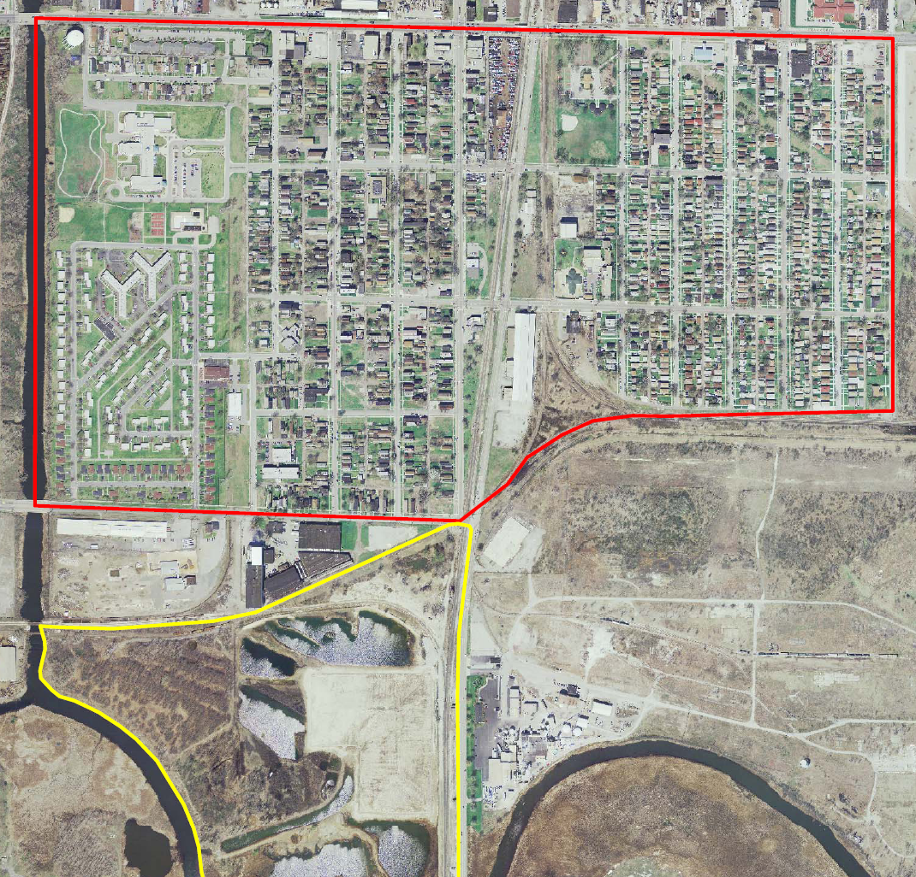
Notes:
Describe study area: IHC to Parrish, Chicago Ave to 150/151st, note that facility has already has a RCRA closure to address the most contaminated area and show big scoops and pile of stuff at SWMU

Slide 3
Site History
Multiple Polluters in Area
  USS Lead
  Anaconda Lead/International Refining
  Dupont
RCRA Corrective Action 2002
On NPL September 2008
Removal Actions 2008, 2011
  Excavation and Off-Site Disposal
  29 total addresses

Slide 4
EPA Lead RI/FS
Aerial Deposition of Lead
Former Anaconda Operations at Public Housing Area
Contamination Isolated to Fill Layer
  Native Sands ~2 feet bgs
Yards: 47% Require Remediation

Slide 5
Schedule
Currently: EPA Developing Cleanup Options
  Costs Range: $40 - $70 Million
Proposed Plan: EPA Proposes Remedy
  Issued Late Spring
  Public Meeting
  Public Comment Period
Record of Decision: EPA Selects Remedy
  September 2012
Cleanups Commence – 2013 or 2014

Slide 7
National Remedy Review Board
Sites with Cleanup Costs > $25 Million
Exemptions – Presumptive Remedies or Simple Yard Excavations
Residential Lead Cleanup – 2003 Guidance
  Excavation and Off-Site Disposal
IDEM Concurs

Slide 8
Discussion

