Slide 1
USS Lead Superfund Site
Notes:
NPL listing process
Now able to spend Fed dollars

Slide 2
Topics
Superfund Program
Superfund Process/Timeline
USS Lead upcoming Schedule
Questions/Discussion

Slide 4
USS Lead Schedule
Remedial Investigation 2010
Cleanup Study
Feasibility Study 2011
Evaluation of Cleanup Options
Proposed Plan late 2011
EPA Proposes Cleanup
Record of Decision early 2012
EPA Selects Cleanup

Slide 5
USS Lead Schedule cont’
Remedial Design 2012
Remedial Action 2013

Slide 6
Notes:
Describe study area: IHC to Parrish, Chicago Ave to 150/151st, note that facility has already has a RCRA closure to address the most contaminated area and show big scoops and pile of stuff at SWMU

Slide 7
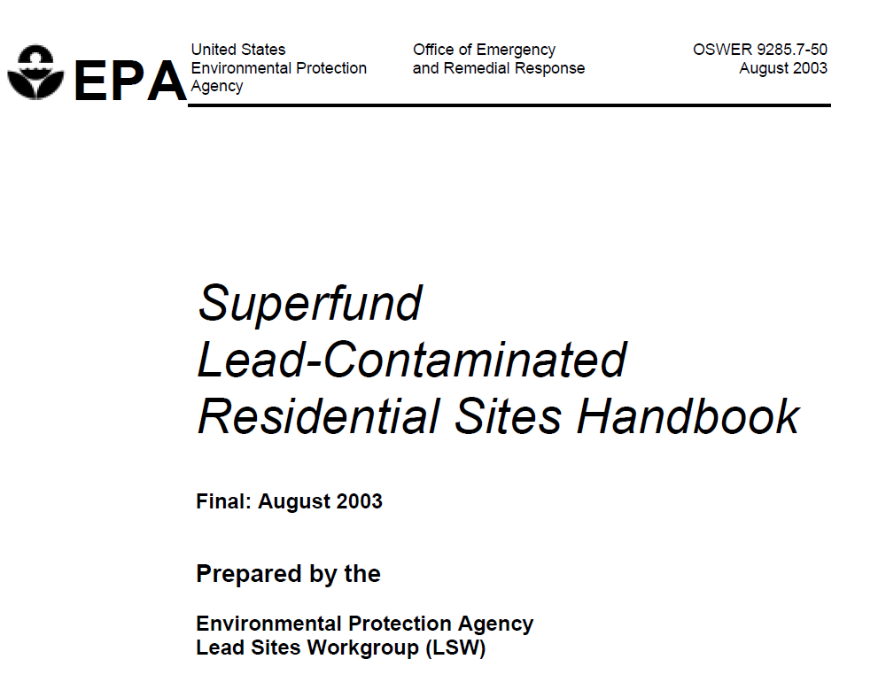
Current Sampling Activities
Technique – Following Superfund Lead-Contaminated Residential Sites Handbook approach
Notes:
Note that EPA has dealt with a number of these sites across the country and has devised an approach that covers the possibilities

Slide 8
Current Sampling Activities
Nature and Extent of Contamination
Geographic Range - Attempting “coarse grid pattern” with 1 to 2 properties sampled per block
Depth – collecting samples down to 2 ft (previous work focused on surface)
Phased Approach – this is phase 1 before more focused investigation, probably next summer

Slide 9
Investigation techniques
Composite samples from front and back yards
Individual samples from play areas and gardens
Composite samples from drip lines (or gutter outfalls)
Subset of properties will be sampled for other contaminants besides metals
Notes:
Note that we are not trying to subdivide yards, but are treating each yard as a single entity that either all stays or all goes. (Might note that kids will not exclusively use one part of yard, but will wander around)
Play areas and gardens are where people will come into contact with soils, so we pay special attention to them
“Subset” might cause some worries, but I think we can lean on past studies which have shown no other issues than lead. We are just confirming that in this phase – will dig deeper next time if thios phase shows that we ought to.

Slide 10
Sampling strategy
Notes:
Based on USEPA Experience at Residential Lead sites across the country

Slide 11
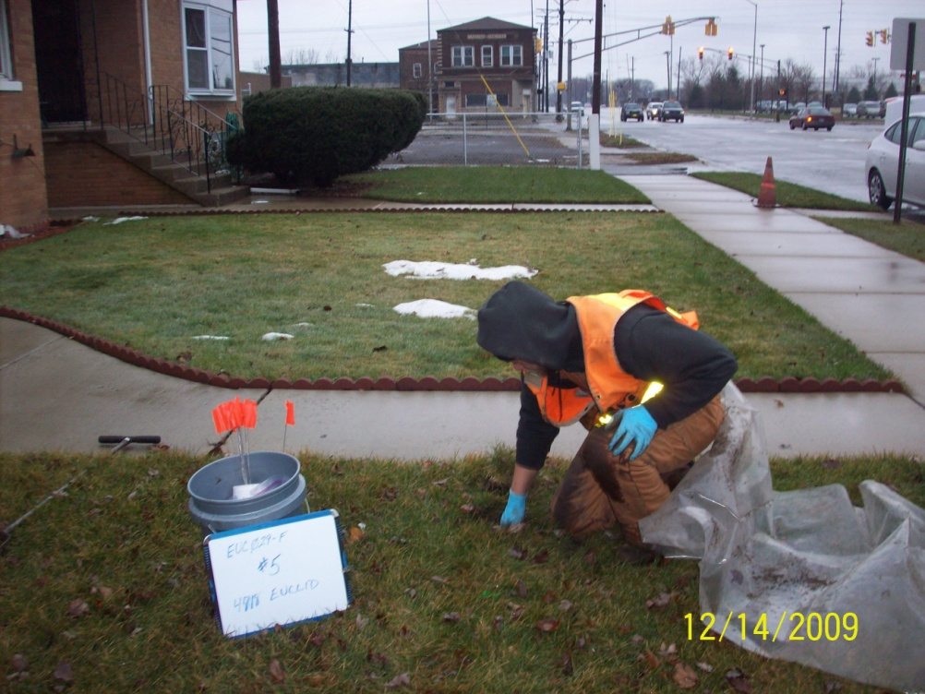
Collecting Samples

Slide 12
Phase II
Phase II investigation will incorporate results from current sampling
Closer density?
Additional compounds still needed?
Others?
Phase II is expected to commence summer 2010

Slide 13
Contact Information
Michael Berkoff
Berkoff.michael@epa.gov
312-353-8983
Janet Pope
Pope.janet@epa.gov
312-353-0628

Slide 14
Technical Assistance Grant
http://www.epa.gov/superfund/community/tag

Slide 15
Questions/Discussion
http://www.epa.gov/region5superfund/npl/indiana/IND047030226.htm
http://cfpub.epa.gov/supercpad/cursites/csitinfo.cfm?id=0501433
Fact Sheet about Lead and Health:
http://www.atsdr.cdc.gov/tfacts13.pdf
Notes:
The ATSDR reference is new – it’s ATSDR’s fact sheet about lead.

Slide 16
Possible Cleanup strategy

